Slide 1

Vue.js & Electron
Adv Topics - Web Dev - PROG1024I
Research Project
Brian Aylward & Derrick Geraghty
Notes:
Good morning everyone, today Derrick and I, will be giving you a lesson on Vue.js and Electron. We plan to keeping it as light and entertaining as possible, please feel free to ask questions anytime or stop us if we are going too fast.

Slide 2


What is Vue.js?
Vue.js is an open-sourced JavaScript Framework that uses the model-view-viewmodel (MVVM) architecture.
Vue.js was created by the software developer Evan You.
Inspiration for Vue.js came from AngularJS.
Evan You basically took all of the best parts of Angular, and turned them into a lightweight incredible framework to create single-page-applications and user interfaces.
Notes:
So what is Vue.js? Vue.js is an open-sourced JavaScript Framework that uses the model-view-viewmodel (MVVM) architecture.
Vue was created by the software developer Evan You after he finished working at Google with AngularJS.
Evan took all of the best parts of Angular and turned it into a lightweight incredible framework to create dynamic single page apps and user interfaces.

Slide 3
Declarative Rendering
//Place this inside your html head
<script src="https://unpkg.com/vue@3.0.2"></script>
<script src="app.js" defer></script>
//Place this inside your html body
<div id=”app”>
{{ message }}
</div>
//Place this in your app.js file
const app = Vue.createApp({
data: function() {
return {
message: "Hello From Vue!!",
};
},
});
app.mount("#app");
This is literally all the code you need to experience Vue.js for the first time.
It completely eliminates the need to go into your html files anymore.
Just like Angular, you can build this out into a component based layout or simply insert it into any page as you desire.
Notes:
At the core of Vue.js is a system that enables us to declaratively render data to the DOM using straightforward template syntax. (You have seen the same thing in Angular)
In this example, you can use the Vue.JS CDN to import all the required Vue files and just get straight to the action, all you need is to fill in alittle bit on your index.html file and a create quick app.js file to get going.

Slide 4
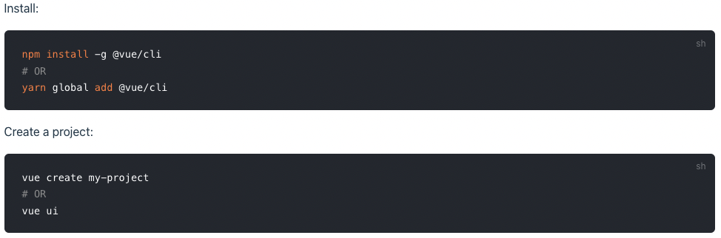
Vue CLI
Just like Angular, Vue.js has a CLI that you can install using Node Package Manager. The Vue CLI is a full system for rapid development.
Notes:
***Read Slide***
The CLI includes:
Interactive project scaffolding
Zero config rapid prototyping
A runtime dependency that is:
Upgradeable;
Built on top of webpack, with sensible defaults;
Configurable via in-project config file;
Extensible via plugins
A rich collection of official plugins integrating the best tools in the frontend ecosystem. and
A full graphical user interface to create and manage Vue.js projects.

Slide 5
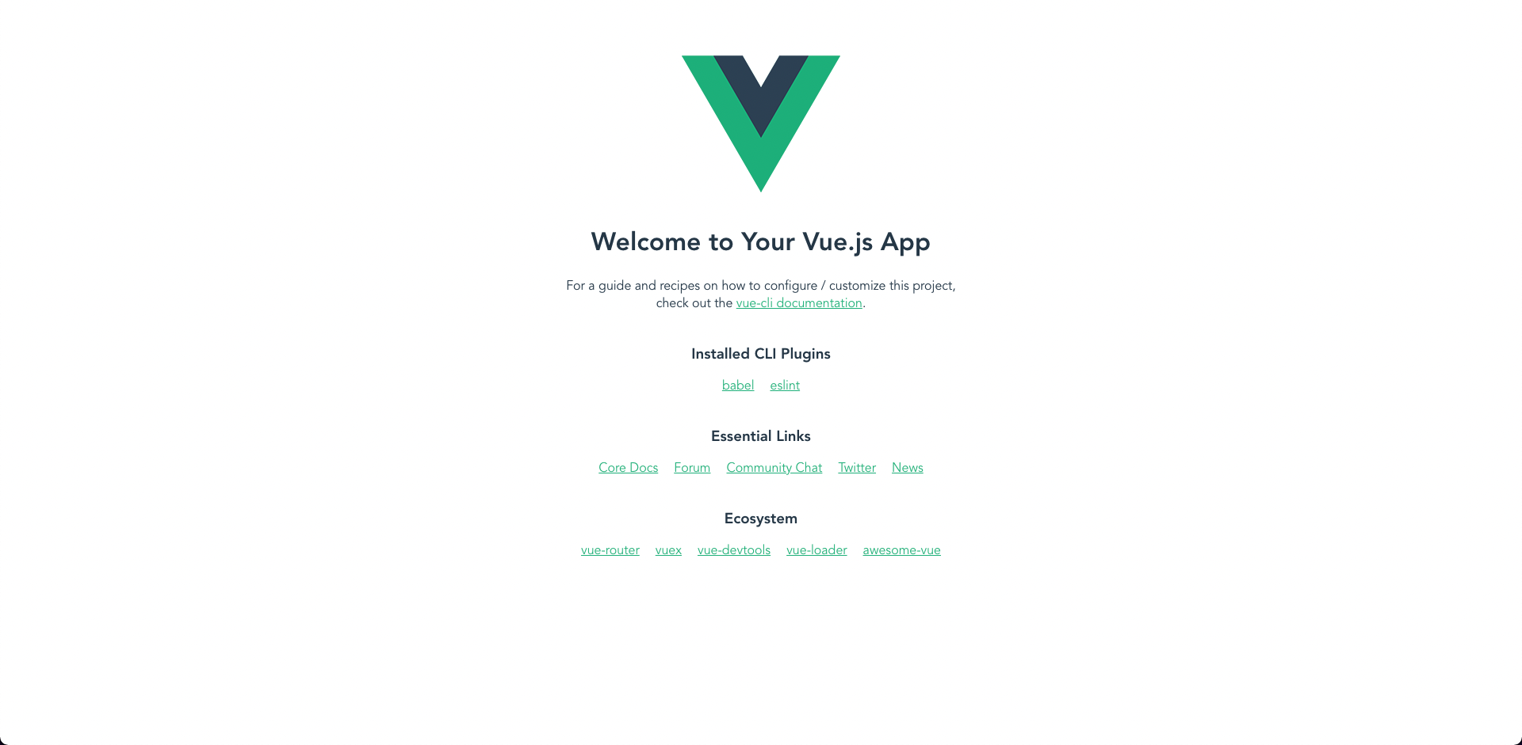
Your first Vue.js CLI Project
Notes:
After you first create a new Vue project with the CLI command vue create project-name, you run npm run serve just like Angular and a template page will already be created for you. I am sure you can see the benefit of this,

Slide 6
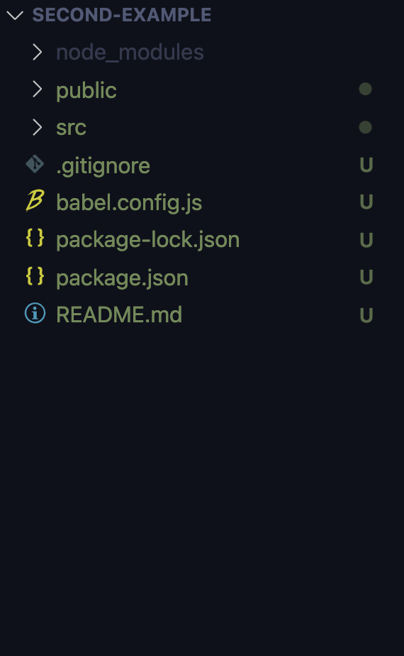
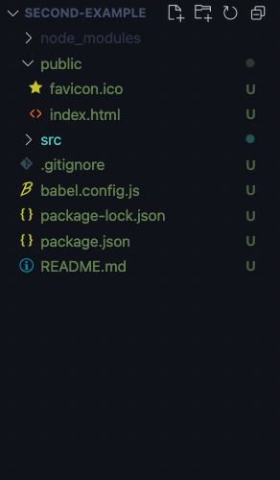
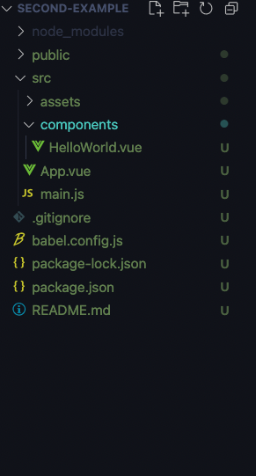
Your first Vue.js CLI Project
Notes:
All of your project files will be nicely organized in a manner similar to what we used in Node and Angular, your public folder will be used primarily for front end JavaScript, or any external Stylesheets you want to add to a project.
Your components and logic will go into your src folder as well as your assets like images.
You will also find your main index.html in your public folder, this is the main page that Vue will use to bind all of your components to. If you ever run into issues with Vue not displaying your components properly, the first place to check is your index.html for your <div> with an id of “app”.

Slide 7
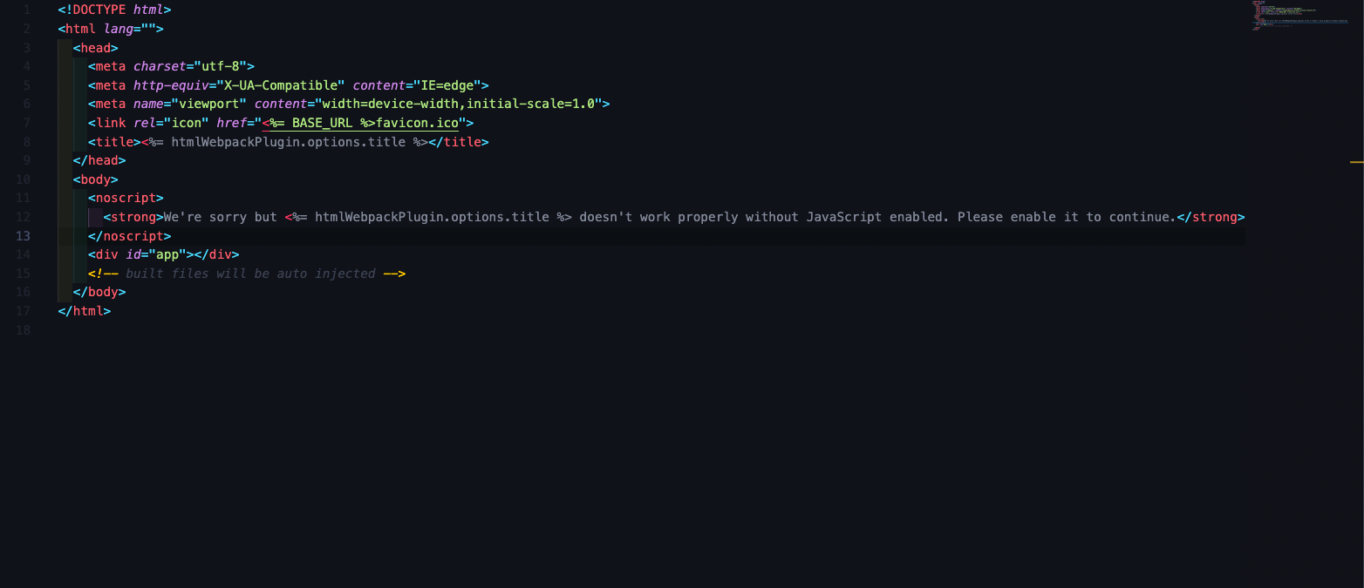
Generated index.html

Slide 8
Built-In Directives
Vue.js has a massive amount of built-in directives that are used throughout any projects.
Notes:
For anyone familiar with Angular,
These directives will look extremely similar and very easy to implement.

Slide 9
Built-In Directives
v-show: Toggle the elements visibility based on the expression used.
v-if: Conditional statement used to display an element
v-else & v-else-if: Used with the v-if statement to have other conditional logic
v-for: For loop used to display content multiple times based on the source data
v-on: Used to attach an event listener to an element (shorthand = @, e.g. @click=””)
v-bind: Dynamically bind one or more attributes (shorthand = :, e.g. :class=””)
v-model: Create a two-way binding on a form input element or component
Notes:
Most of these will seem very familiar, and I am sure you will enjoy using the shorthand syntax for the more common ones.
There are more but these are the main ones you might see if you ever plan to use Vue.js for personal projects.
Vue.js also supports creating custom directives. For example, if you wanted to create a directive to have the focus set on a particular input field on page load, you could programmatically create your own directive and implement it with a v-focus syntax.
**Read Slide**
You will be able to explore and use a lot of these in our upcoming demo.

Slide 10

What is Electron JS
Electron is an open source library developed by GitHub for building cross-platform desktop applications with HTML, CSS, and JavaScript.
Electron accomplishes this by combining Chromium and Node.js into a single runtime. Apps can be packaged for Mac, Windows, and Linux.
Electron is Developed by Github and Led by Cheng Zhao

Slide 11
Electron VS Web Apps
Electron behaves like a native web app, which makes it easy to understand for anyone that has experience with HTML, CSS and Javascript.
However, because Electron apps are installed locally on your machine, they have the ability to read and write to local files on your machine as well as connect with peripheral devices and other local hardware.
Electron applications can also be run offline since they do not require internet

Slide 12




Popular Examples
Visual Studio Code
Discord
Skype
Slack
Mailspring
Streamlabs OBS
Atom text editor
And many more
Notes:
Most of these will seem very familiar, and for I am sure you will enjoy using the shorthand syntax for the more common ones. We will be using a few of these in our demo coming up.
There are more but these are the main ones you might see if you ever plan to use Vue.js for personal projects.
Vue.js also supports creating custom directives. For example, if you wanted to create a directive to have the focus set on a particular input field on page load, you could programmatically create your own directive and implement it with a v-focus syntax.

Slide 13
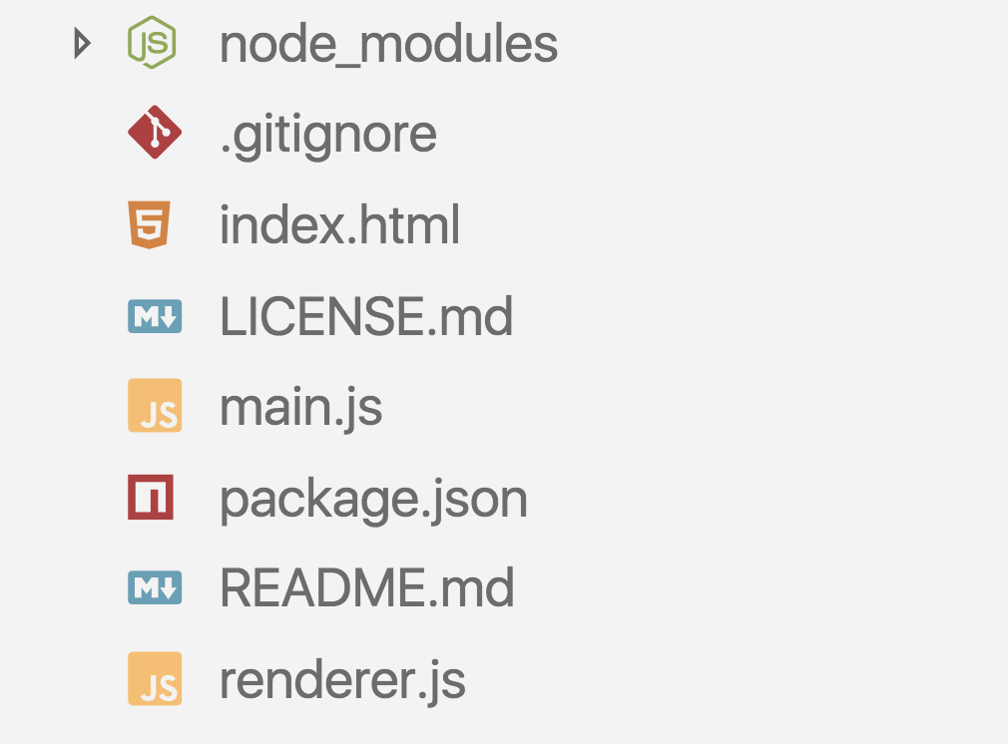
Electron Folder Structure
Index.html is the main page, and main.js is the main process point.

Slide 14
How do you create a new Electron application?
Node.js must be installed before to use Electron.
To check if Node.js is installed - Use the command
“node - v”
Step 1) Create a folder for your Electron application and perform an “npm init” in the root of that folder
The three main parts required in the npm init we need to complete for our Electron application are the entry point, author and description.
The entry point should be “main.js” - The main Electron file to run.
And description and author can be any value, but they are required for app packaging.

Slide 15

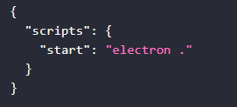
How do you create a new Electron application?...
Step 2) run the command “npm install –save-dev electron” to install the Electron package as a dev dependency
Step 3) You must configure a script to run our application - In the scripts field of the package.json file, add a start command like so:

Slide 16
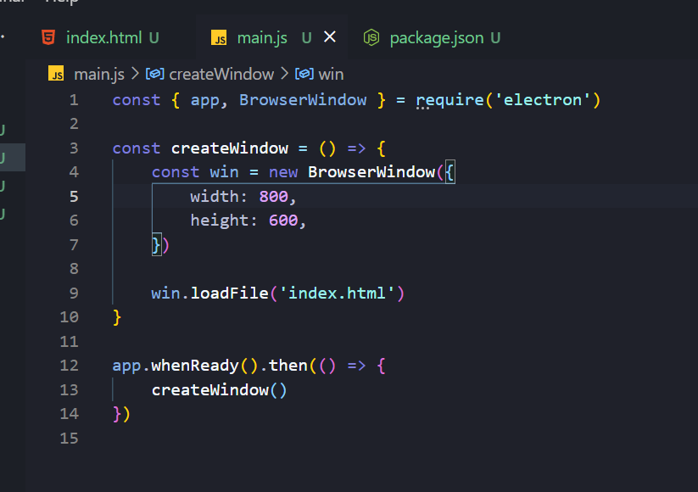
How do you create a new Electron application?...
Step 4) You must now create an index.html with the boilerplate html code, this is the file that our front end is going to display in our electron app.
Step 5) Finally, we must create a main.js file with the following code for requiring electron, creating our window and then calling that createWindow function on the app.whenReady handler

Slide 17
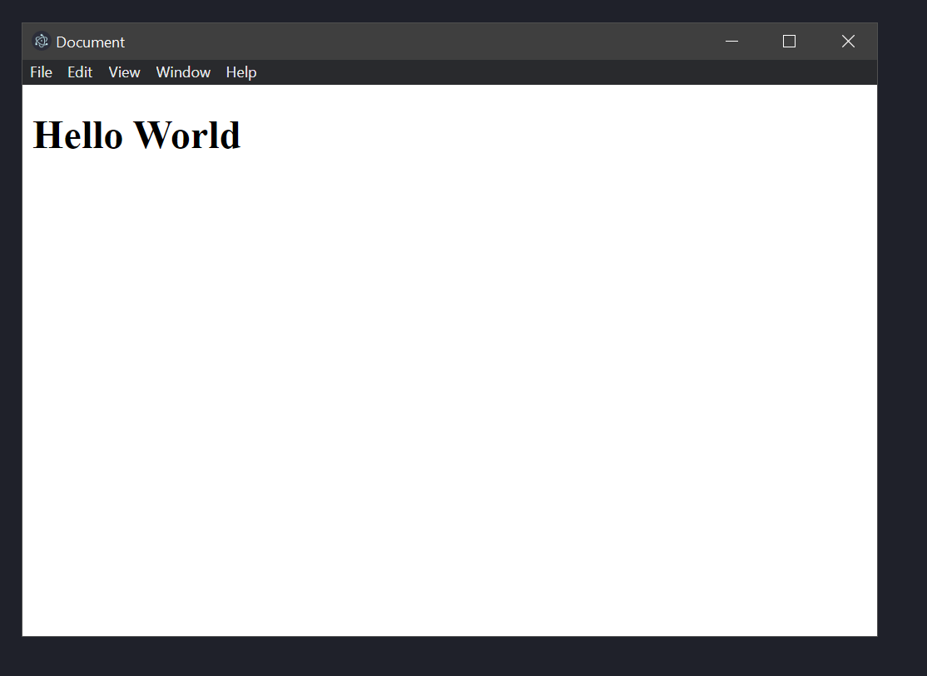
Our First Application
Now, after running the command we created earlier (“npm run start”), our electron window with our HTML page will display. Creating an Electron app is as simple as that.

Slide 18

VUE Electron-Builder
Electron-Builder is a complete solution to convert a Vue application to a desktop Electron application - We will be using this today
Utilizing Electron-Builder is very easy. Open a Vue application and run the command vue add electron-builder. This will scaffold anything needed and create our script files.
The newly scaffolded files are going to look a little different than a natively created Electron application. We will go over these new files.

Slide 19


Lets get started!
We’ll get started by getting the Vue CLI installed and trying out some Vue functionality.

Slide 20
Lets get this rolling
Fork and clone this repository link on Github
https://github.com/BAylwardWMAD/Vue-Electron-Research

Slide 21
Resources
Below you can find our resources we have used to learn our research topics:
https://v2.vuejs.org/v2/guide/
https://www.electronjs.org/docs/latest
https://stackoverflow.com/
https://www.youtube.com/watch?v=YrxBCBibVo0&list=PL4cUxeGkcC9hYYGbV60Vq3IXYNfDk8At1
https://www.electron.build/

